Slide 1
Brain Tumor Detection by CNN
Presented by Joey Gaule

Slide 2
Table of contents
01
04
07
02
05
08
03
06
09
Problem Statement
Feature Engineering & Transformations
Results & Learnings
Assumption & Hypothesis
Model & Hyperparameter Tuning
Future Work
Exploratory Data Analysis
Model Selection
Conclusion

Slide 3
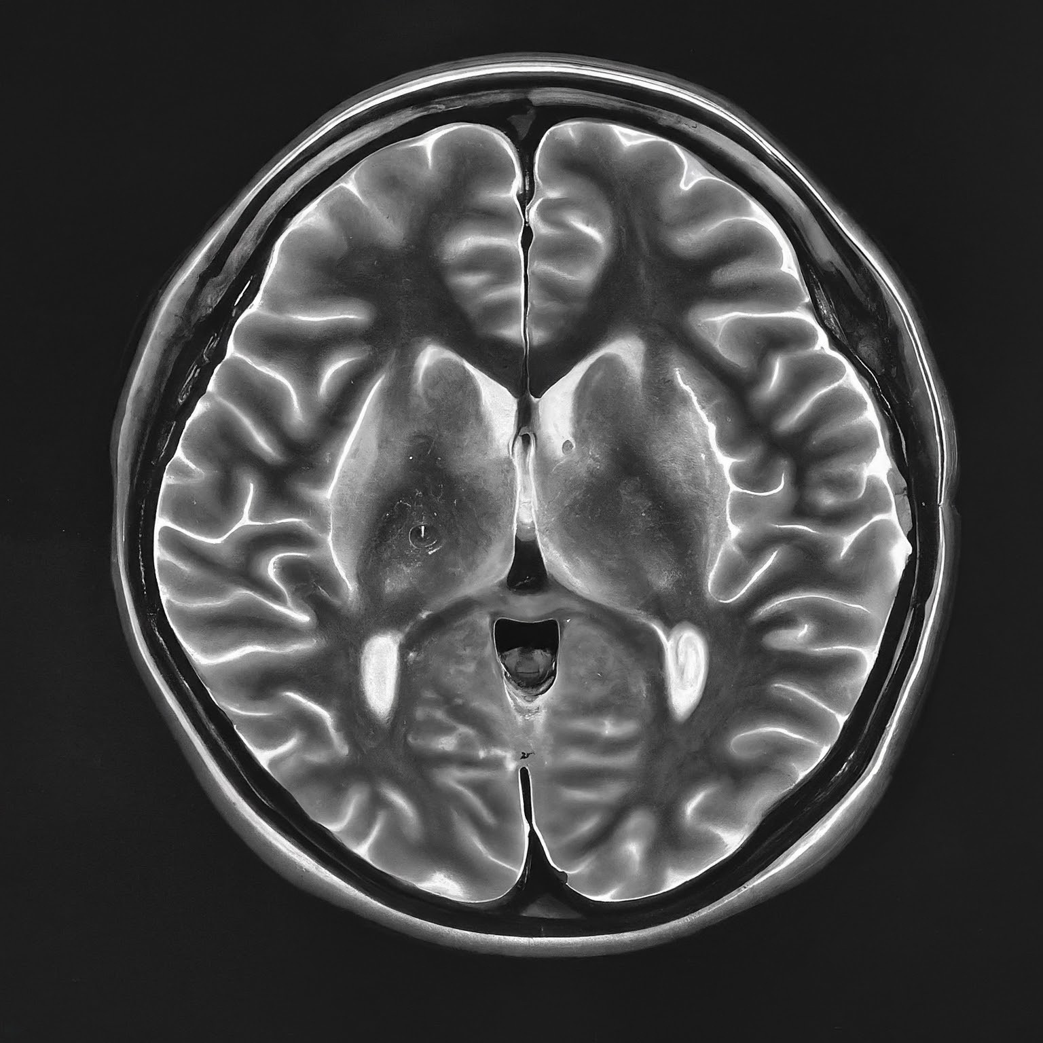
Problem Statement
Detection and classification of brain tumors are two very important stages in diagnosis and planning for the treatment of a patient. Nevertheless, manual interpretation of medical images, such as MRI scans, can be a consuming, subjective process and might lead to possible errors and delays in patient care.
There is a need for a reliable automated means for the detection and classification of brain tumors from medical images.
Ultimately, this work is intended to increase the ability and accuracy of diagnosis in a manner that rightly and promptly plans the treatment of the patients.

Slide 4
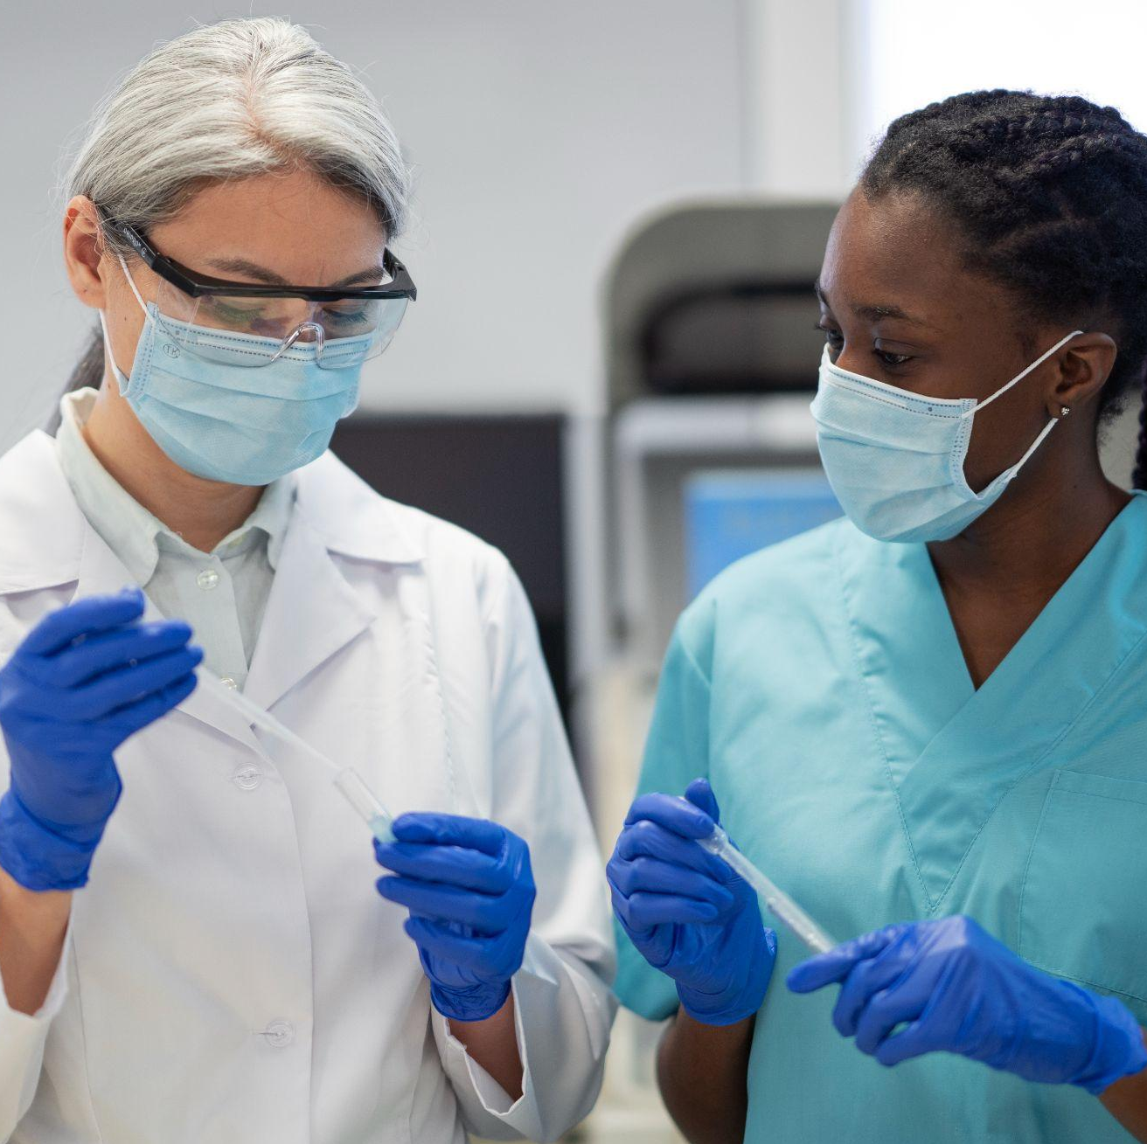
Assumptions & Hypothesis on
the Data & Model
Assumptions:
The dataset contains images labeled as either "tumor" or "healthy".
The images are of sufficient quality and resolution to allow the model to learn distinguishing features.
Breakthrough vision
Hypotheses:
CNNs will be effective in extracting spatial hierarchies from MRI images, leading to high classification accuracy.
Data augmentation techniques will help in improving the model's robustness.

Slide 5
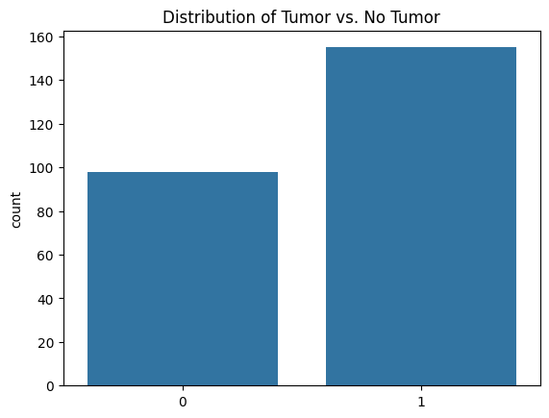
Exploratory Data Analysis
Dataset:
Brain MRI Images for Brain Tumor Detection from Kaggle.
Data Loading and Preprocessing:
Resizing, normalization.
Data Distribution:
Distribution of tumor vs. no tumor.
Sample images.
Insights:
Patterns and anomalies.
Class imbalance.

Slide 6
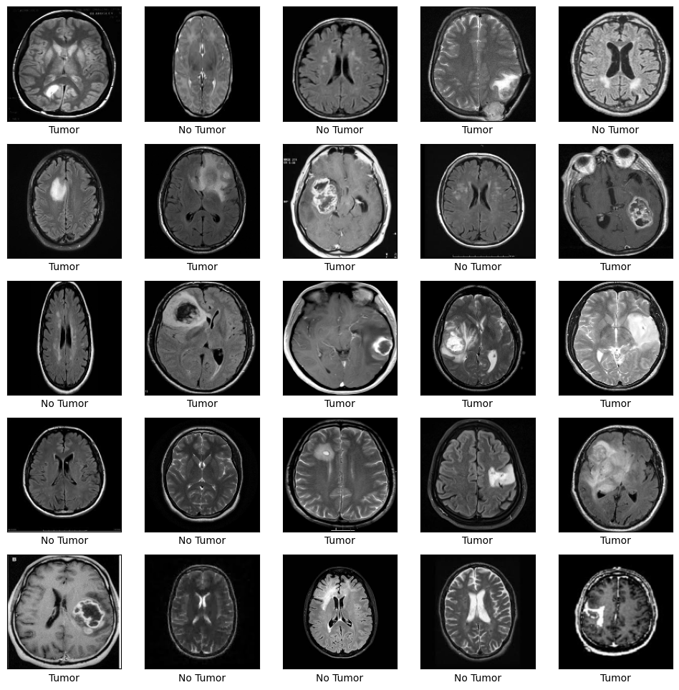
Exploratory Data Analysis
Data Loading and Preprocessing: We began by loading the MRI images and preprocessing them. Preprocessing steps included resizing the images to a uniform size and normalizing pixel values to a range of [0, 1].
Data Distribution: The distribution of images showed a noticeable class imbalance, with more images labeled as having tumors than not. Sample images were visualized to understand the variety and quality of the data.
Insights: During EDA, we observed patterns such as the distinct visual differences between tumor types and identified anomalies such as images with potential labeling errors. The class imbalance was particularly notable, which could affect model performance.

Slide 7
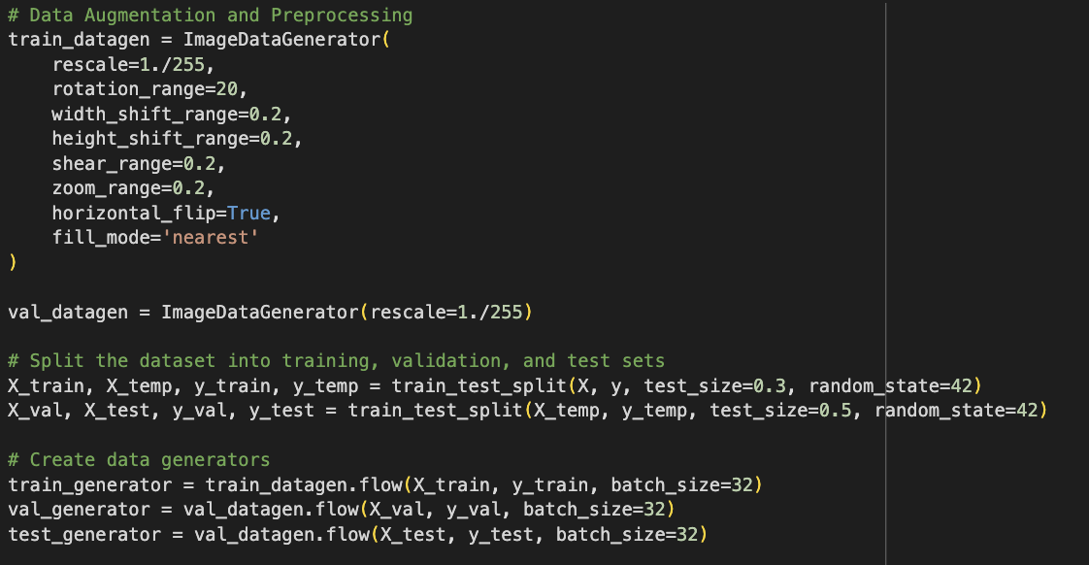
Feature Engineering & Transformations
Preprocessing:
Convert images to grayscale.
Resize images to a uniform size.
Normalize pixel values.
Data Augmentation:
Techniques: rescaling, rotation, width and height shifts, shear, zoom, and horizontal flip.
Purpose: Increase dataset size and diversity to improve model generalization.

Slide 8
Feature Engineering & Transformations
Image Augmentation: To address the class imbalance and improve the model’s ability to generalize, we applied several augmentation techniques. These included rotating, shifting, and zooming the images to create variations.
Normalization: Normalizing the images involved scaling the pixel values to a range between 0 and 1, which helps in stabilizing the training process and improving convergence.
Transformation Steps: The images were resized to a consistent dimension and converted to grayscale for simplicity. Data augmentation and normalization were crucial steps in preparing the data for training the CNN model.

Slide 9
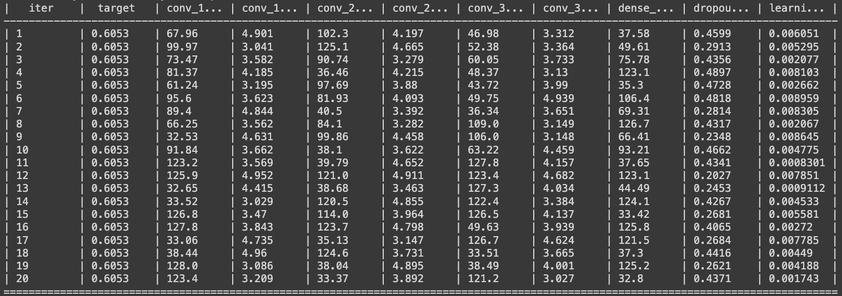
Model with Checks for Overfitting/Underfitting & Bayesian Optimization
CNN Architecture:
Layers: Convolutional, MaxPooling, Flatten, Dense, Dropout.
Activation functions, optimizer, and loss function.
Hyperparameter Tuning:
Use Bayesian Optimization to find the best hyperparameters.
Define parameter space and perform optimization.
Overfitting/Underfitting:
Use early stopping and model checkpoint callbacks.
Evaluate validation performance during training.

Slide 10
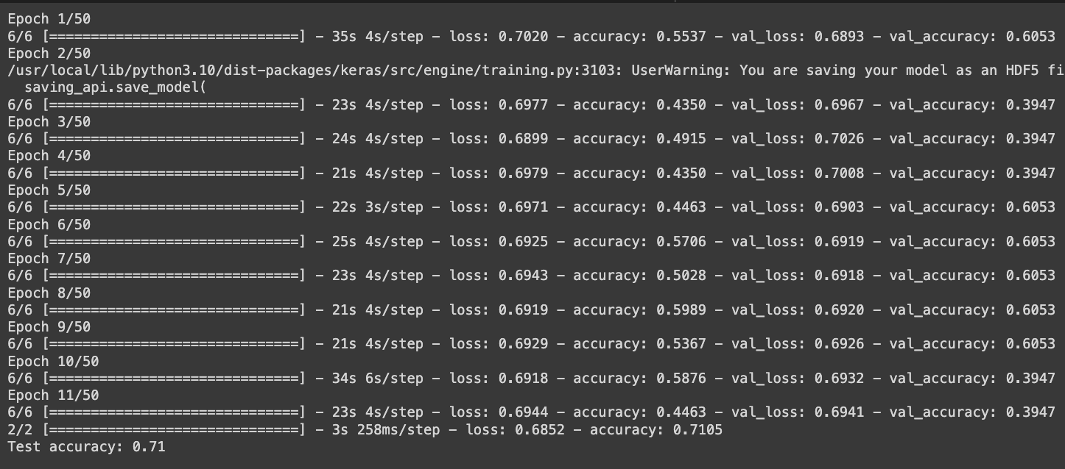
Model Selection with Regularization
Final Model:
Retrain model using the best hyperparameters obtained from Bayesian Optimization.
Use Dropout for regularization to prevent overfitting.
Training:
Train the model using the best hyperparameters.
Monitor training and validation accuracy.
Evaluation:
Evaluate the model on the test set.

Slide 11
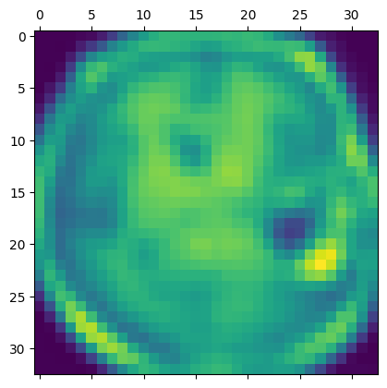
Results and Learnings from the Methodology
Explainable AI:
Use Grad-CAM to visualize model's focus areas.
Display heatmaps for sample images.
Interpretation:
High Attention Areas (Bright Yellow):
indicate regions with high importance according to the model. In this case, the model has focused on a specific area which likely contains a tumor.
Moderate Attention Areas (Green):
shows moderate attention, indicating that the model also considers these regions but with less importance.
Low Attention Areas (Dark Blue):
Regions are areas where the model paid little to no attention, suggesting that these areas are not critical for its decision-making process.
Clinical Relevance:
This visualization helps verify that the model is focusing on clinically relevant areas, such as potential tumor locations, which aligns with medical expertise.

Slide 12
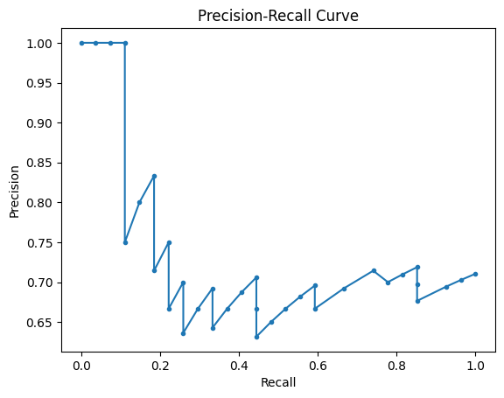
Model Selection with Regularization
Performance Metrics:
Accuracy: 0.71
ROC-AUC: 0.46
PR AUC: 0.73
Confusion Matrix:
Predicted all test instances as tumors.
Learnings:
Imbalanced data led to strong bias towards tumor class.
Low ROC-AUC indicates poor class distinction.
Despite reasonable PR AUC, performance for no tumor class is inadequate.

Slide 13
Future Work
Address Class Imbalance:
Data Augmentation: Generate synthetic data for no tumor class using SMOTE or ADASYN.
Class Weighting: Adjust class weights during training.
Advanced Architectures and Techniques:
Ensemble Methods: Combine multiple models to improve performance.
Transfer Learning: Fine-tune pre-trained models like VGG16, ResNet, etc.
Evaluation Metrics:
Additional Metrics: Specificity, sensitivity, balanced accuracy.
Cross-Validation: Ensure consistent performance across different subsets of the data.

Slide 14

Future Work
Explainability and Interpretability:
Further explore explainability techniques like LIME and SHAP.
Integration with Clinical Data:
Combine imaging data with clinical data (e.g., patient age, symptoms) for a comprehensive model.
Real-World Deployment:
Validate the model on larger and diverse external datasets.
Address data privacy, ethical considerations, and regulatory compliance for safe clinical deployment.

Slide 15
Conclusion
Despite not achieving the anticipated accuracy, the results of this project are promising and show significant potential for further advancements. The methodologies and techniques used, including CNNs, Bayesian Optimization, data augmentation, dropout regularization, and Grad-CAM visualizations, demonstrate a sophisticated approach to brain tumor classification.
Key findings highlight the need to address class imbalance and integrate clinical data with imaging data to improve model robustness. Future work will focus on these areas, using ensemble methods and transfer learning with pre-trained models to enhance accuracy. Validating the model on larger, diverse datasets and adhering to ethical and regulatory standards will help bridge the gap between research and clinical application.
This project lays a strong foundation for continued exploration and refinement, advancing machine learning in medical imaging and ultimately improving patient care.

Slide 16
Helpful Resources
Dataset:
Github:
https://drive.google.com/file/d/1-P5inWT-DGW-ToNdq5veFQUyN-UymWNe/view?usp=sharing
https://github.com/joeygaule/ML-Projects.git

